Slide 1


RCB Victory Roadmap – Developing An Effective Auction Strategy
Dharshika Singh
13/03/2025

Slide 2

About Royal Challengers Bangalore
Royal Challengers Bangalore hold the record for lowest ever total in IPL history, which was against Kolkata Knight Riders in Eden Garden.
RCB failed to chase a target of 132 runs and was only able to score 49 runs in response.
Royal Challengers Bangalore played the 1st ever IPL match. It was against Kolkata Knight Riders and Brandon McCullum smashed a record breaking 158*, a record which was broken only after 5 years by RCB Batsman Chris Gayle with 175 off just 66 balls against Pune Warriors India.
This Photo by Unknown Author is licensed under CC BY-NC

Slide 3

Analysis Objective
To develop an auction strategy and bag the best players.
Suggest players that are best fit and can help RCB win the championship.
Present past performance of current RCB players and other players in IPL and find the players who are most consistent.
Analyze the team's weakness and strengths to scout players who can fit into the team.
Form an auction strategy that will help RCB bring in match winners.

Slide 4

IPL Dataset Overview
Ball by Ball
Match_id: Unique identifier for a cricket match
Over_id: Unique identifier for an over in a cricket match
Ball_id: Unique identifier for a ball in an over
Innings_No: The innings number in a cricket match
Team_Batting: The team batting in a particular innings
Team_Bowling: The team bowling in a particular innings
Striker_Batting_Position: The batting position of the striker batsman
Striker: The batsman currently on strike
Non_Striker: The batsman currently at the non-striker's end
Bowler: The bowler bowling the current delivery
Runs_Scored :The runs of the batsman
Batting style
Batting_id: Unique identifier for a batsman's batting record
Batting_hand: The batting hand (right or left) of a batsman
Bowling style
Bowling_id: Unique identifier for a bowler's bowling record
Bowling_skill: The bowling skill (e.g., right-arm fast, left-arm spin) of a bowler
City
City_id: Unique identifier for a city
City_Name: The name of a city
Country_id: Unique identifier for a country

Slide 5
Extra Type
Extra_Type_Id: Unique identifier for the type of extra runs scored in a cricket match.
Extra_Runs: The number of extra runs scored in a particular delivery.
Innings_No: The innings number in a cricket match.
Ball_Id: Unique identifier for a ball in an over
Over_Id: Unique identifier for an over in a cricket match.
Season
Season_Id: Unique identifier for a particular season or tournament.
Man_of_the_Series: The player awarded the Man of the Series award for a particular tournament.
Orange_cap: The player awarded the Orange Cap (for most runs scored) in a particular tournament.
Purple_cap: The player awarded the Purple Cap (for most wickets taken) in a particular tournament.
Season_year : The year in which the season was held
Win_By
Win_Type: The type of win (e.g., runs, wickets) achieved by the winning team.
Win_Id: Unique identifier for every win type
Outcome
Outcome_type: The type of outcome or result of the match (e.g., win, loss, tie, no result).
Outcome_Id: Unique identifier for the outcome or result of a match.
Out_Type
Out_Id: Unique identifier for the type of dismissal or way a batsman got out.
Out_Name: The name or description of the type of dismissal (e.g., caught, bowled, lbw, run out).

Slide 6

Umpire
Umpire_id: Unique identifier for an umpire officiating the match.
Umpire_name: The name of an umpire.
Umpire_country: The country or nationality of an umpire.
Toss Decision
Toss_Name: The name or description of the toss (e.g., heads or tails).
Player
Player_Id: Unique identifier for a player.
Player_Name: The name of a player.
Rolee
Role_Id: Unique identifier for a player's role or skills (e.g., batsman, bowler, all-rounder).
Role_Desc: Description of a player's role or skills.
Team
Team_Id: Unique identifier for a team.
Team_Name: The name of a team.

Slide 7
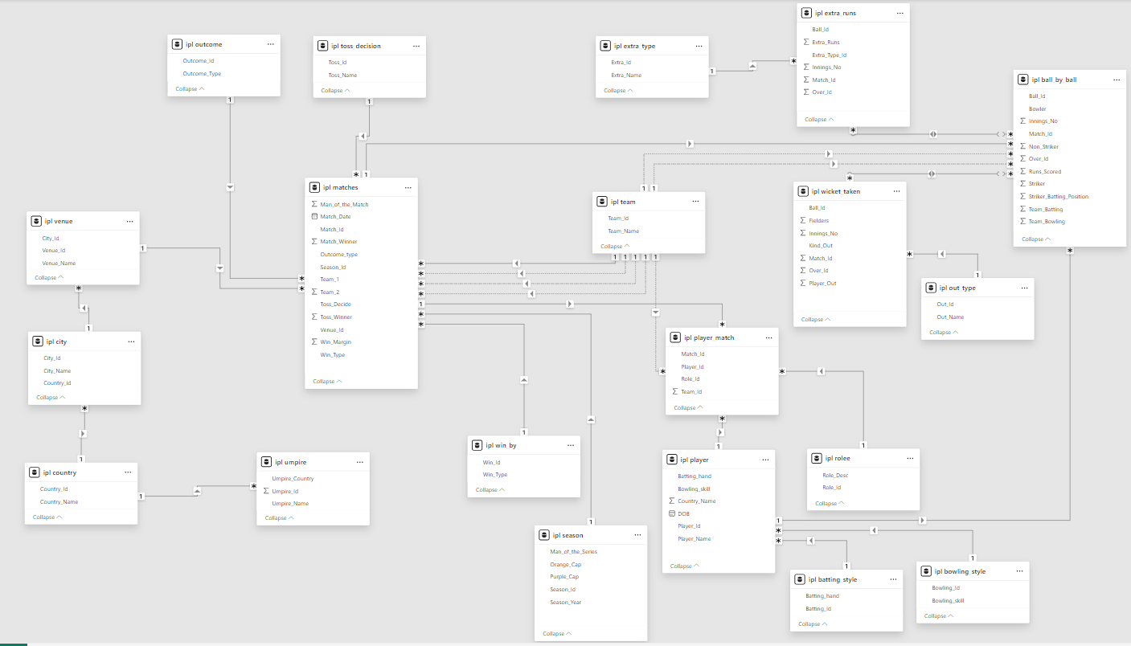
Database Schema

Slide 8
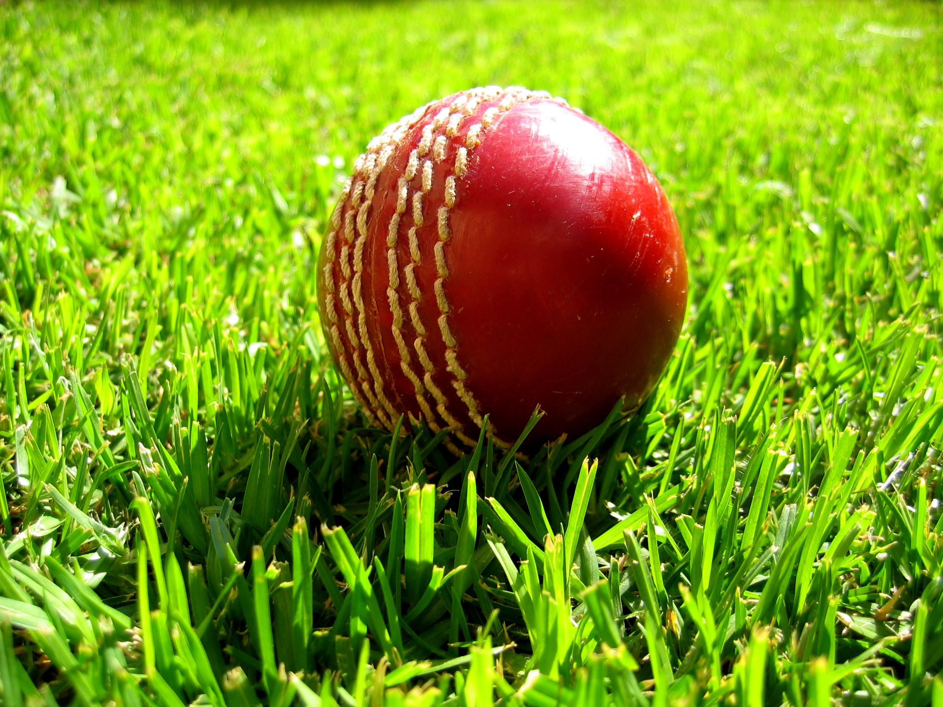
Methodology
Data Cleaning: Used UPDATE statement to update the team name correctly from Delhi Capitals to Delhi Daredevils.
Data Aggregation: Used various aggregation functions such as SUM(), AVG(), COUNT(), etc. To aggregate data and get a meaningful summary.
Data Manipulation: Used various JOINS and SUB-QUERIES to combine different tables and manipulate the data for easier analysis.
Data Measurement: Measured the performance of various players using functions like LIMIT, DENSE_RANK(), ROW_NUMBER().
Data Visualization: Visualized the output to summarize the data, gain meaningful insights and identify any trends.

Slide 9
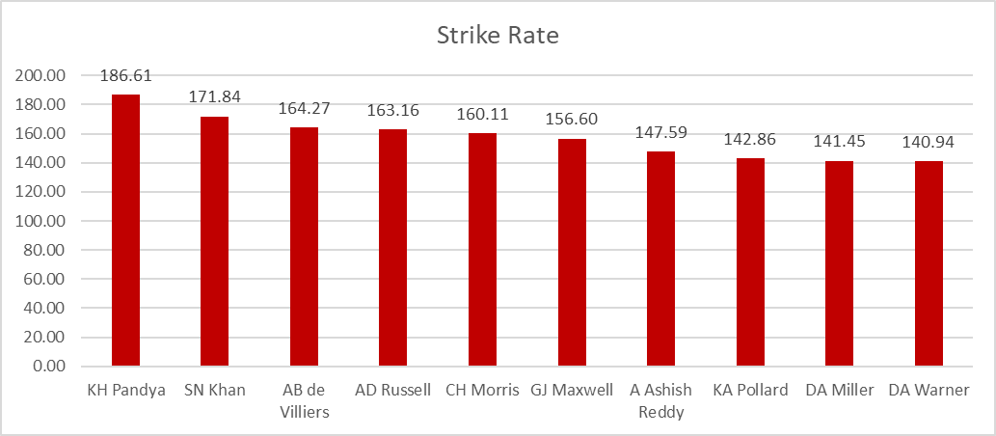
Strike rate is the rate at which the batsman scores runs.
We can see that KH Pandya has the highest strike rate from the past 4 seasons with an impressive 186.71
Followed by SN Khan and AB de Villiers with 171.84 and 164.27 strike rate respectively.

Slide 10
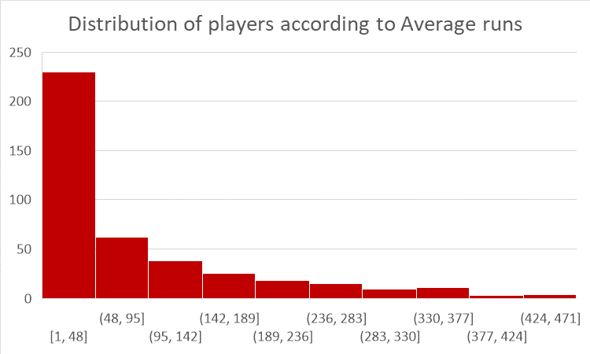
We can see that most of the players have an average between 1 and 95, with the majority of them falling in 1-48 runs rage for their entire IPL career till date.
Some exceptional players have average runs between 189 to 471 where only handful of players have average run greater than 377

Slide 11
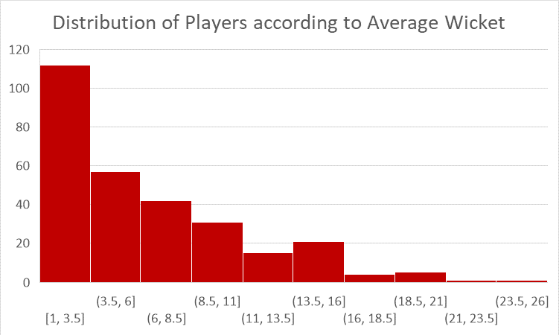
We can observe that only few players fall in the 16+ average wickets range and the least number of players have average wickets more than 21
The majority of the players have average wickets between 1 to 11 and 1 to 3.5 being the range where most of the players fall in.

Slide 12
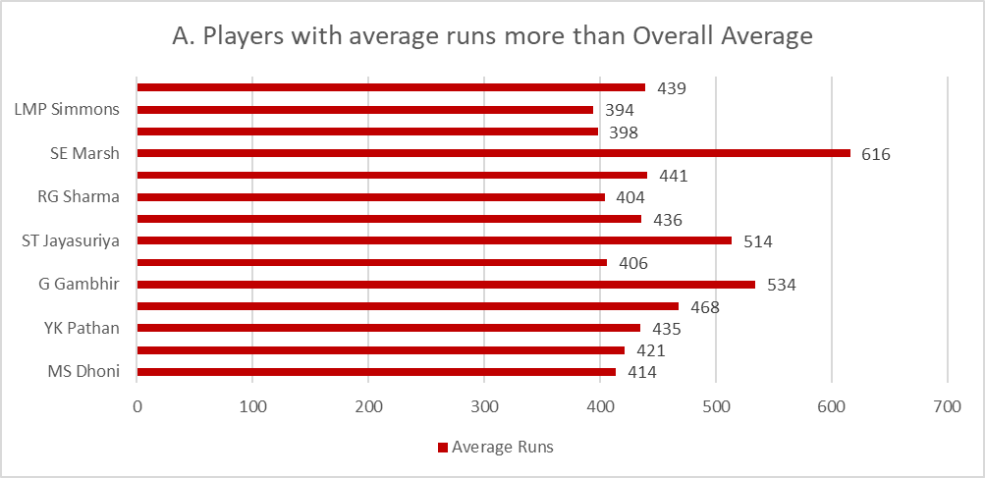
We can see that SE Marsh tops the list with more average runs then overall average, followed by G Gambhir and ST Jayasuriya.
LMP Simmons and F du Plessis barely make the cut with 394 and 398 runs respectively.

Slide 13
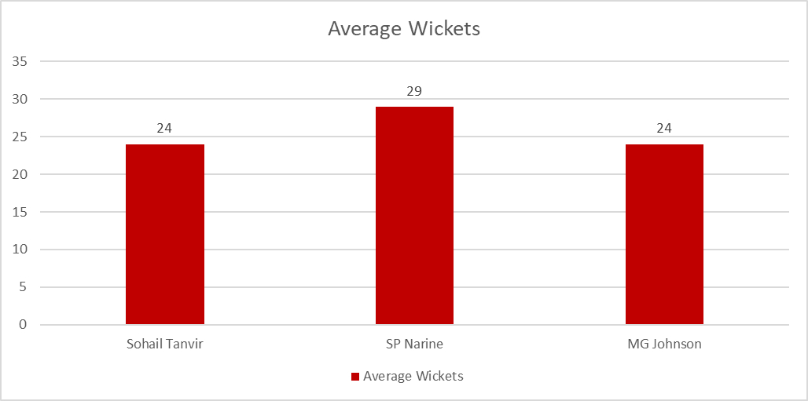
We can see that only 3 players have average wickets greater than overall average of wickets.
It can be observed that SP Narine is leading the charge with an average of 29 wickets followed by Sohail Tanvir and MG Johnson which both tie at 24 wickets each.

Slide 14
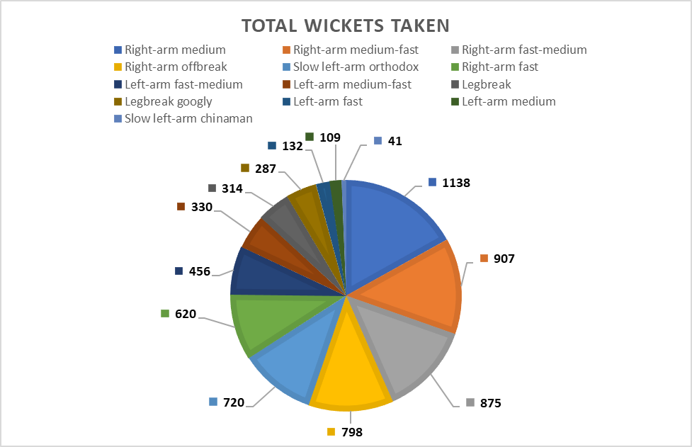
We can see that Right-arm medium styled bowlers take the most wicket with 1138 wickets followed by Right-arm medium-fast with 907 wickets and Right-arm fast-medium with 875 total wickets.
Slow left arm chinaman sits lowest in the wickets column with just 41 total wickets, this could be because bowlers with this style is rare and batsman usually don’t take risks against them and play defensively.

Slide 15
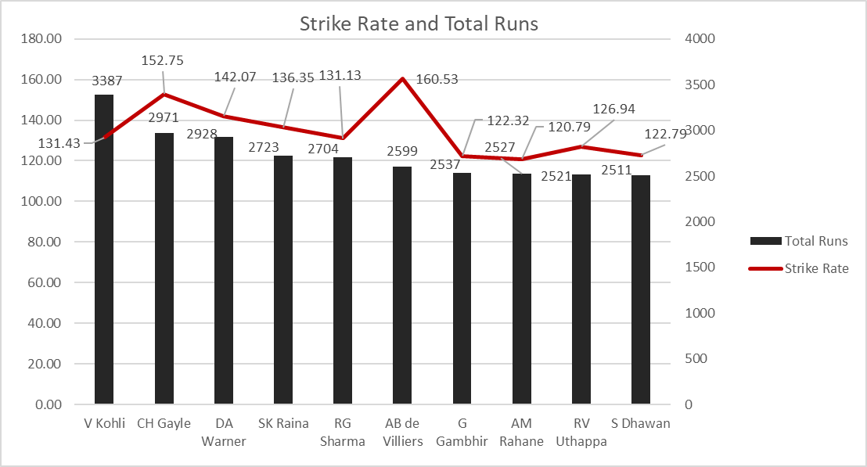
Above are the top 10 players with excellent strike rate and total runs. This helps in identifying the best batsman for our fit.
Gambhir has been 2 times IPL winning captain and has led his side from the depths of defeat to victory which can be very fruitful for RCB to bag a championship.
Uthappa has been the Orange Cap winner in KKR’s 2014 season and was the backbone of the sides batting line-up, we can have him in our line-up to play the anchor role for the innings.

Slide 16
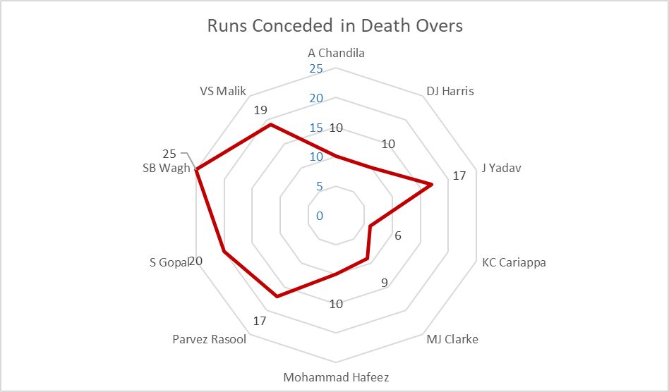
Death over performance is crucial for a bowler because the batting team aims to swing at every ball in that phase.
If the bowler concedes less run during this phase then RCB can restrict their opponents to a low total or defend their own total efficiently.
We can see that KC Cariappa has a really good economy rate in the death overs of just 6 runs.

Slide 17
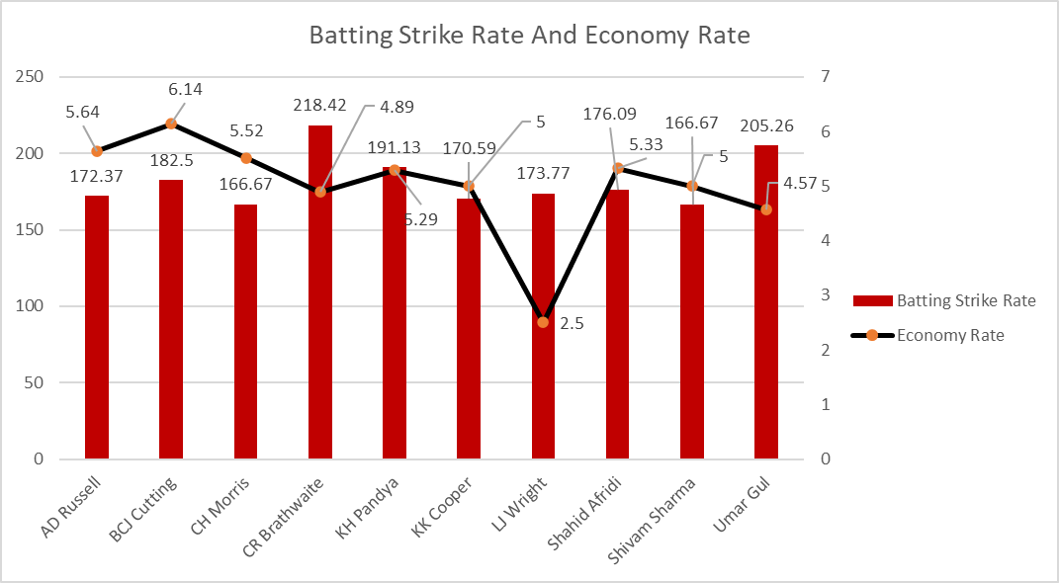
All-rounders are very important in a cricket team as they provide flexibility in selecting the playing IX.
Additionally, they also help the captain implement on the fly bowling strategies or change the batting line-up to counter their opponents.
AD Russell and CR Braithwaite are 2 of the balanced all-rounders, on a good day they can prove to be match winners for their team.

Slide 18
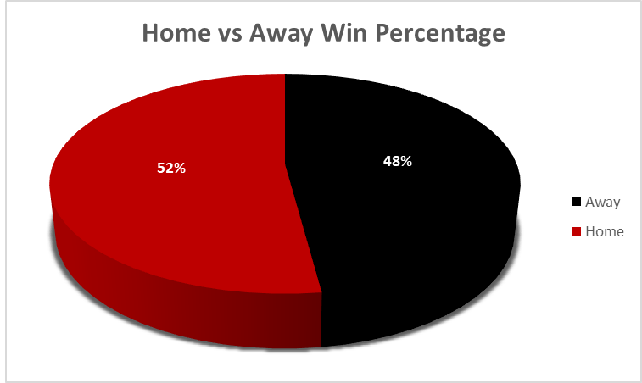
We can see that when it comes to winning RCB has a very slim home advantage.
RCB wins 52% of the matches they play at home and 48% of matches they play away.

Slide 19
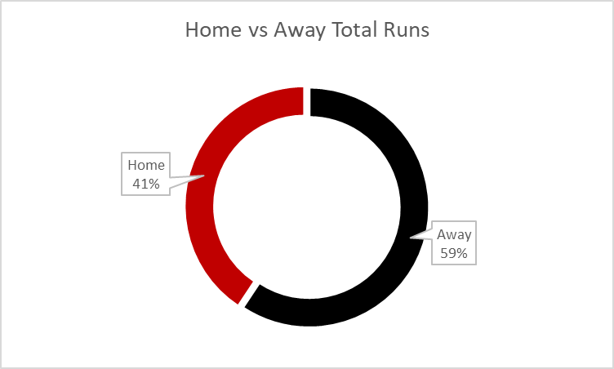
This chart is surprising as RCB scores less runs at home and more runs away.
Despite their home venue being one of the highest scoring venues in IPL, they made only 41% of their total runs at home and 59% away.

Slide 20
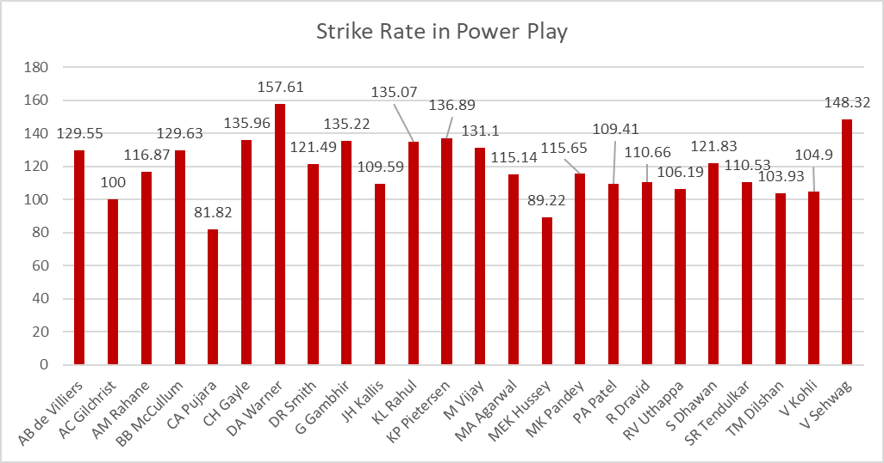
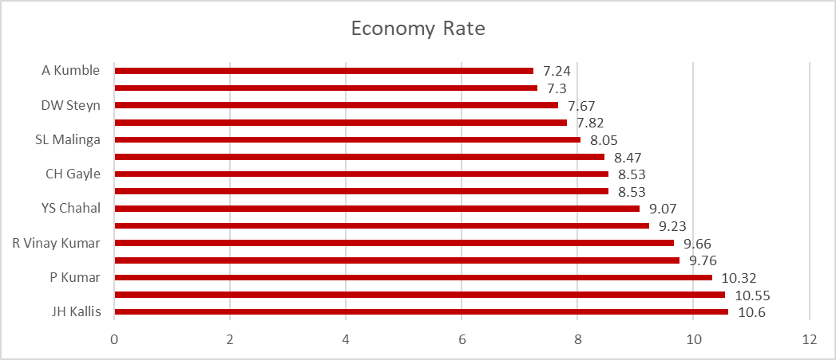
We can observe that no player in RCB has strike rate more than 180 in the power play.
Having high strike rate in the power play sets the team up to put up a good total.
A good power play helps ease pressure off of the batsman further down the line.
Having a good start while batting is important both when we put up a total and when we are chasing a total.
We can see that RCB bowlers during death overs are not very economical.
No bowlers in the death over have economy rate less than 7.
Low economy rate in death overs helps in restricting the opposition to a low total.
Good death over performance helps in defending low totals as well

Slide 21
Conclusion
In conclusion, RCB needs to improve its win percentage to be strong team in the IPL.
Having explosive batsman that can give a flying start in the powerplay phase can help in boosting the teams total and ease pressure on other batsmen
Good economic bowlers can help in defending low totals and also restricts opposition batsmen from putting a high total.
Also, RCB needs to capitalize home ground advantage more than they do currently.
They win more matches away then they win at home.
They should focus on getting bowlers that could take advantage of conditions at home more often.
Getting high performing all-rounders are also recommended and can be the difference between winning and losing the match.

Slide 22
Thank You

